Slide 1
CSCI-1620
Object Oriented Programming I

Slide 2
Data type
What is a data type?
What type of data can be used to store a whole number?
What type of data can be used to store a number with a possible fractional part?
Notes:
Set of characteristics that define a piece of data

Slide 3
Data type
Why can’t you use an int to store a fractional number?
What are the primitive data types in Java?
What are the characteristics of an int?
  What information or values is a single int capable of storing?
  What behaviors or actions can be performed with an int?

Slide 4
Data type
What type of data can be used to store a Bank Account?

Slide 5
Classes
The idea of a Bank Account is more complex than what our primitive data types are capable of representing
It is possible to define our own data types so we can have a data type to represent whatever we may need
These data types are defined by creating a Class
Data types that are defined by Classes are known as Reference types, as they are handled a little differently than the primitive types

Slide 6
Classes
The idea of a Reference type is similar to the primitive types
Like int, a class isn’t a piece of data, rather it defines the characteristics of a piece of data
  Think of a Class as a blue print or template
Like int, you can use a Class to create data based upon the data type’s characteristics

Slide 7
Classes
Assume this code:
int x, y;
What can be done with x and y?
How do you know those actions can be done with those variables?

Slide 8
Classes
Classes are no different, if there is a piece of data that was created from a class, the definition of the class defines what that piece of data is capable of doing
A piece of data created based on a class definition is an object
  It may also be referred to as an “instance” of that class
  An object, or instance, is a specific realization of a class
  House blueprints is to the constructed house as
  A class is to an object, or instance

Slide 9
Classes
What are Reference types you’ve used often and are provided by the Java environment?

Slide 10
Classes
Classes define two major things
  What the data type stores (data members)
  What the data type does (member methods)
    Including one or more Constructors
      What happens when an instance of this data type is created

Slide 11
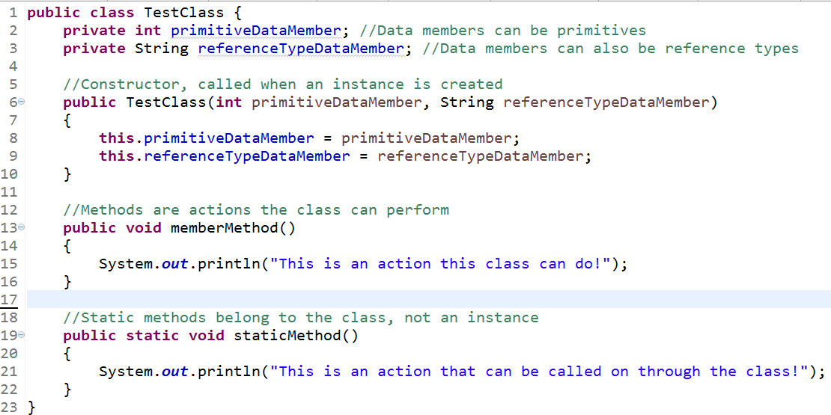
This is an example class. It defines what a piece of data called “TestClass” will look like; what data it stores and what it can do. A Class on its own is not a piece of data, rather defines what a piece of data would look like if created. It is like the blue print for a piece of data.

Slide 12
Static vs. Non-static
Data members and Member methods can be declared to be static
Static members belong to the Class itself, not any specific instance
They can be accessed through the Class directly, not through an instance like non-static members
Since they belong to the class, static methods cannot access non-static members

Slide 13
Objects
An Object is a realization or instantiation of a Class
Based upon a Class definition, an Object is something that is actually created and takes up memory
Each instance that is created holds its own (non-static) copies of the defined data members and can call upon non-static methods
An Object, or instance of a Class, is created with the keyword “new” followed by one of the Class’ defined constructors

Slide 14
Objects
new TestClass(5, “Some String”);
This will create a new Object, an instance of TestClass based upon the definition created by the TestClass Class. This Object takes up memory and is an actual, existing “thing”, whereas a Class on its own is simply a definition

Slide 15
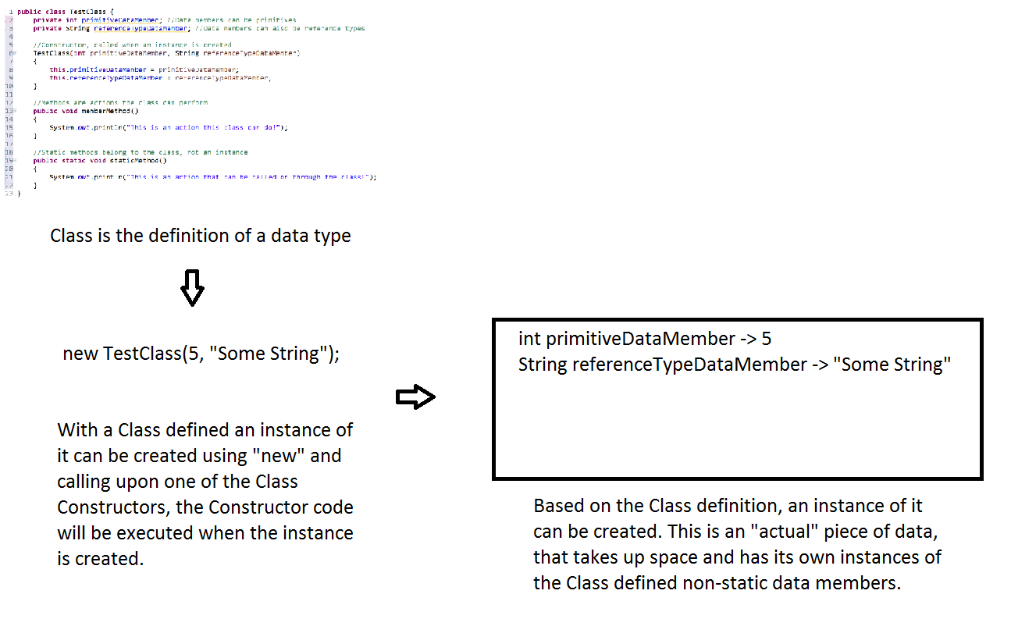

Slide 16
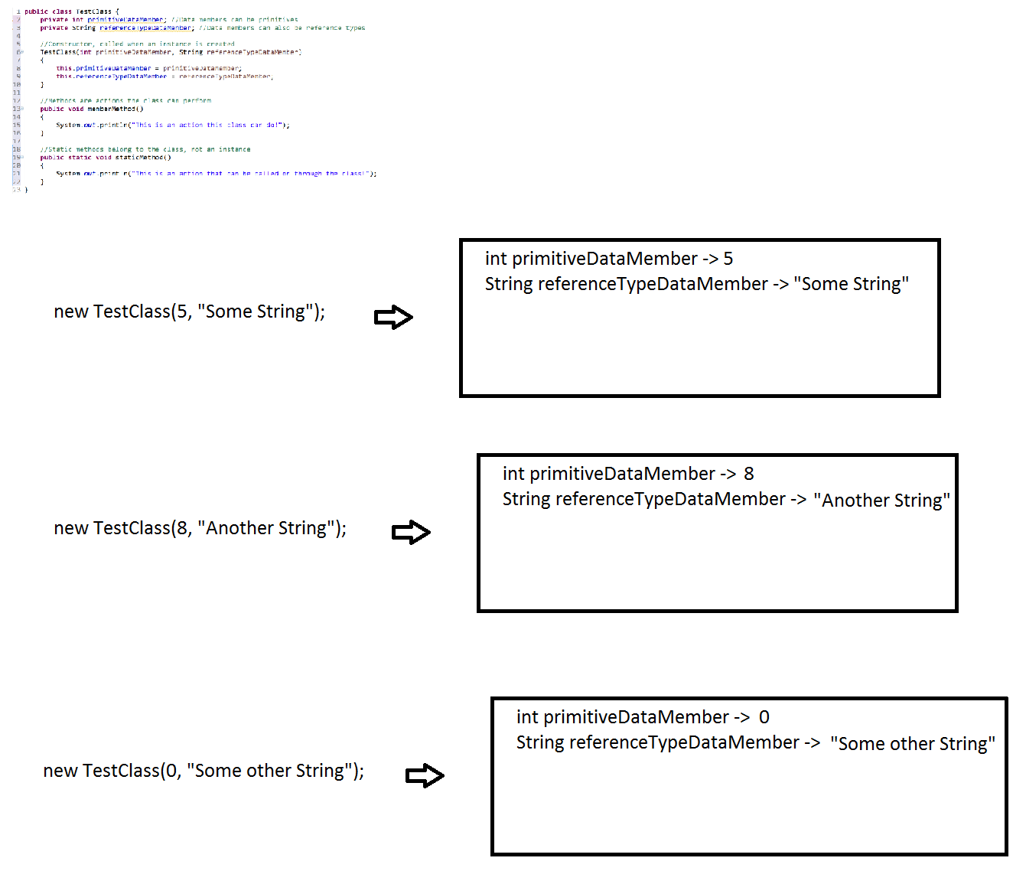
A single Class definition can be used to create many instances, each with it’s own copies of the data members. Similar to how a single blueprint can be used to create, or instantiate multiple houses.

Slide 17
References
Creating an Object, or instance of a Class, allocates space and stores that Object in memory
References are what allow us to access these Objects
You can think of a Reference as a handle, or label for an Object that exists in memory
A Reference is created like primitive variables, giving the type of the Reference followed by an identifier
TestClass var;

Slide 18
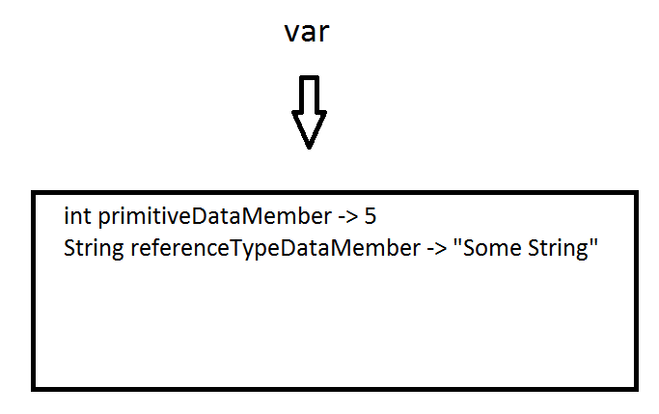
References
A Reference is capable of pointing to, or referencing an Object
TestClass var = new TestClass(5, “Some String);
The right hand side of the assignment creates a new instance of TestClass as seen earlier, the left hand side creates a Reference, or variable, capable of pointing to a TestClass Object
The assignment assigns the Reference to the newly created Object

Slide 19
Accessing Objects
Objects can be accessed through a Reference by using the dot operator
var.memberMethod();
The dot operator here means I want to access the thing that var references, calling upon its “memberMethod” method
Public non-static members can be accessed in this way
Non-static methods can use non-static data members, using the values stored in that instance of the Class

Slide 20
Static Members
Data members and member methods that are declared as static belong to the Class itself, not specific instances
Think of them as those things that are shared between all instances of the Class
They are accessed through the Class name directly
TestClass.staticMethod();
Static member called through the Class name
For static data members, only one value exists
  These work well for constants or a value that needs to be the same for all instances of a Class
Static member methods cannot access non-static data members since the method call is not being done by a specific instance which has its own values

